Slide 1
Employee salary Prediction using XGBoost
CAPSTONE PROJECT
Presented By:
Student Name : Vivekananda Giri
College Name : Odisha University of Agriculture and Technology, Bhubaneswar
AICTE_ID:STU65b90b0f973071706625807
Department: Computer Science and Application

Slide 2
OUTLINE
Problem Statement
System Development Approach
Algorithm & Deployment (Step by Step Procedure)
Result
Conclusion
References

Slide 3
Problem Statement
In today’s fast-paced business world, accurately determining employee salaries is a persistent challenge due to reliance on manual processes, subjective judgment, and limited data analysis.
These traditional approaches often lead to inconsistencies, pay inequities, and employee dissatisfaction, which can ultimately affect talent retention and company reputation.
The aim of this project is to develop a machine learning-based employee salary prediction system that uses multiple employee-related features (such as education level, years of experience, job role, and location) to accurately and objectively estimate salary.
The motive behind undertaking this project is to address these gaps by leveraging machine learning to create a data-driven, objective salary prediction system.
This project addresses the current shortcomings in traditional salary determination processes—namely bias, lack of transparency, and inefficiency—by providing a robust, data-centric solution for fair and competitive compensation management.
This dataset provides the Employee information. It includes over 1,000 records and 19 attributes.

Slide 4
Proposed Solution
The proposed solution for the Employee Salary Prediction project centers on building an accurate and reliable machine learning model to predict employee salaries based on multiple features.
The workflow begins with thorough data pre-processing, including the handling of missing values and the encoding of categorical variables to ensure that the dataset is clean and machine learning-ready.
Classification algorithms, such as Logistic Regression and Random Forest Classifier, are applied to tasks like predicting job types (e.g., on-site, hybrid, remote), while regression algorithms including Linear Regression, Random Forest Regressor, and XGBoost Regressor are used to predict the actual salary figures. The solution will consist of the following components:

Slide 5
Proposed Solution –CONt.
Data Prep
Import libraries (pandas, scikit-learn)
Load & clean data (handle missing values, duplicates)
Encode categorical features, scale continuous features
Model Training
Split data into training and testing sets
Train various models (Logistic Regression, SVM, KNN, etc.)
Evaluate and select the best performing model (e.g., Random Forest)
New Data Prediction
Use the trained model to predict Employee salary for new data points
Overall, this approach provides a framework for Employee salary prediction using various machine learning techniques.

Slide 6
System Approach
Building the proposed solution would involve a combination of data processing, Visualizing dataset, and machine learning. Here are the key system and library requirements:
System requirements:
Hardware:
CPU : The code should run efficiently on modern CPUs, preferably with multiple cores for parallel processing.
RAM: At least 4 GB of RAM is recommended, although more may be necessary for larger datasets or more complex models.
GPU: GPU is optional. If GPU acceleration is desired, a compatible GPU with CUDA support would be necessary.
Software:
Operating System: The code should be compatible with major operating systems like Windows, macOS, and Linux. Ensure that the necessary dependencies are compatible with the chosen operating system.
Software: Python interpreter is required to execute the code. Additionally, a text editor or an Integrated Development Environment (IDE) such as Jupyter Notebook or Google Colab can be used to write, edit, and execute the code. Google Colab can directly execute the provided notebook (.ipynb) file.

Slide 7
System Approach-Cont.
Library required to build the model:
Data Processing and Analysis:-
Pandas: For data manipulation and analysis.
Data Visualization:
Matplotlib
Seaborn
Machine Learning Models:
Scikit-learn (or sklearn)
GUI Development:
Streamlit
Model Persistence:
Pickle

Slide 8
Algorithm & Deployment
These are the steps I have applied Employee salary prediction:
STEP 1 – Dataset Overview & Cleaning
Successfully loaded a clean dataset with 15,000 rows and 19 columns.
No missing values detected.
Converted posting_date and application_deadline to datetime format.
Normalized all categorical fields (lowercase + whitespace stripping).
STEP 2 – Feature Preparation
Dropped irrelevant fields such as job_id, company_name, posting_date.
Encoded categorical columns using LabelEncoder.
Target variable selected: salary_usd.
Final shape for modeling:
Feature matrix (X): 14 columns
Target vector (y): salary_usd

Slide 9
Algorithm & Deployment-Cont.
STEP 3 – Exploratory Data Analysis (EDA)
Created powerful visualizations to identify patterns and trends:
Salary distribution (histogram)
Salary comparison by:
Experience level
Employment type
Remote ratio
Company size
Top 10 most frequent industries
Bivariate Analysis
Key Insights:
Executives earn significantly more than juniors.
Remote roles have broader salary ranges.
Large companies offer higher average salaries than small ones.
STEP 4 – Feature Engineering & ML Preparation
All categorical features encoded numerically.
Used StandardScaler for feature normalization.
Prepared datasets for machine learning (X, y split).

Slide 10
Algorithm & Deployment-Cont.
STEP 5 – Regression Modeling and Model Comparision
Trained 3 different models to predict salary_usd:
Linear Regression:
Random Forest Regressor:
XGBoost Regressor:
Conclusion: XGBoost is the most accurate model for salary prediction in this dataset.
STEP 6 – Visual Model Comparison
Plotted model performance metrics:
R² Score
MAE (Mean Absolute Error)
RMSE (Root Mean Squared Error)
XGBoost clearly outperformed both Linear Regression and Random Forest in all metrics.

Slide 11
Algorithm & Deployment-
STEP 7 – Deep learning Regression Model with Keras
Model Definition
Compiled the model
Trained the Model
Predicted and evaluated the model
Appending it to the result and showing
STEP 8- Model Extraction via Pickle
STEP 9 – NLP Analysis of required_skills
Tokenized skills using CountVectorizer (split by comma).
Counted and visualized the top 20 most frequent skills.
Top Skills Identified:
Python, SQL, TensorFlow, Docker, AWS, Linux, Kubernetes, NLP
This step sets the foundation for building a Employee salary Prediction system.
STEP 10- Model Deployment Using Streamlit

Slide 12
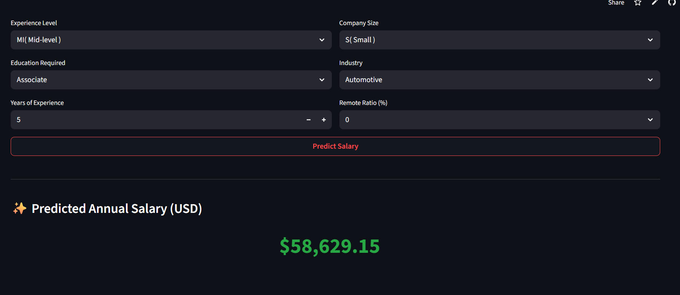
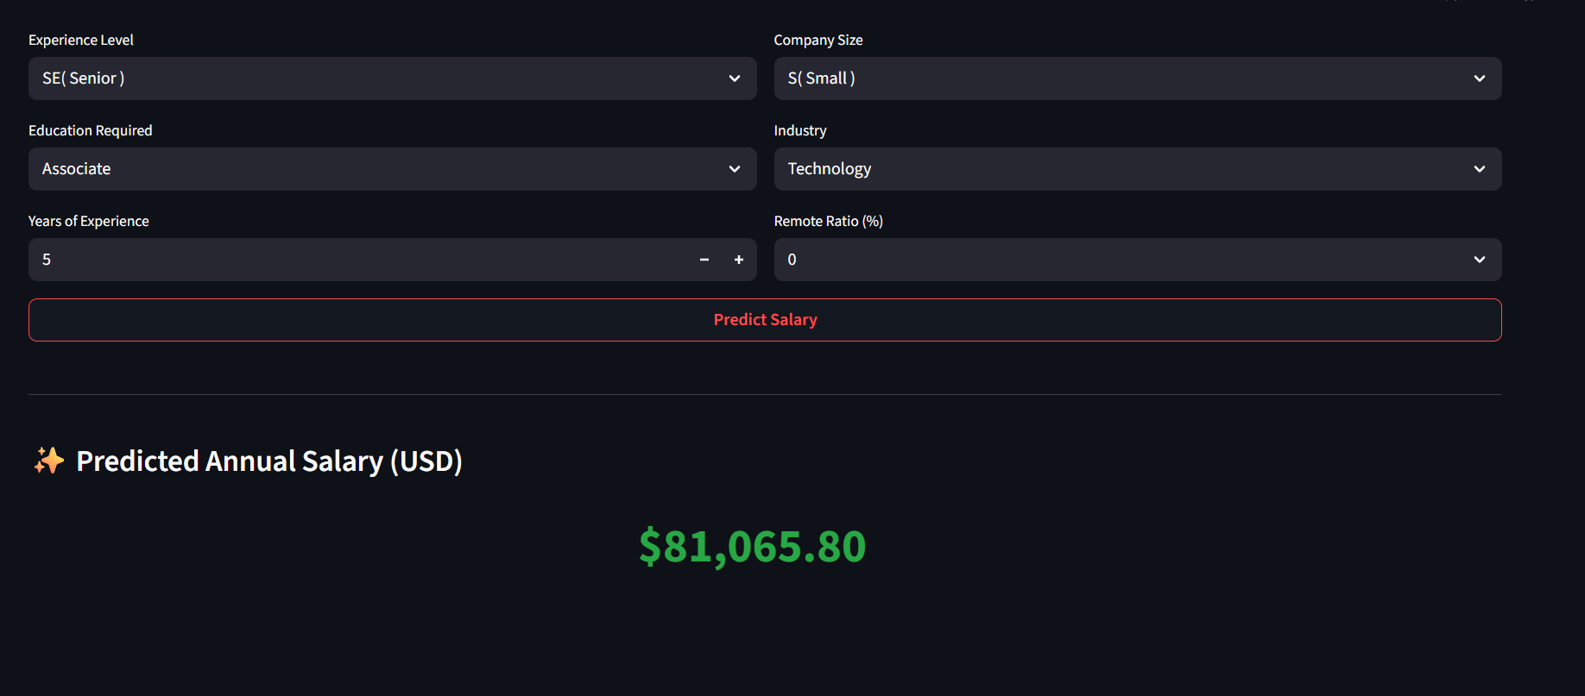
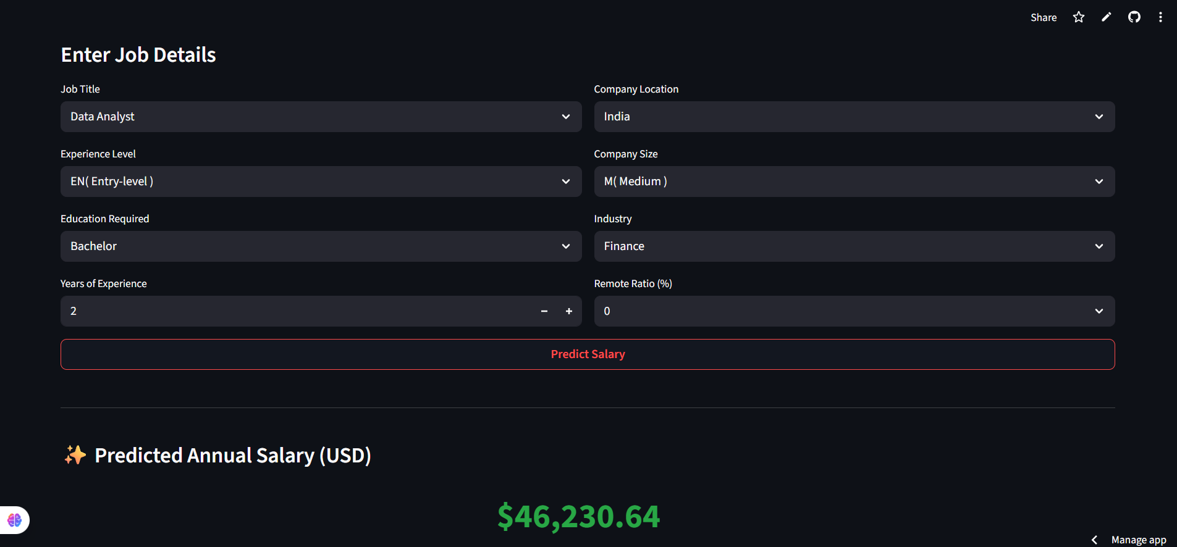
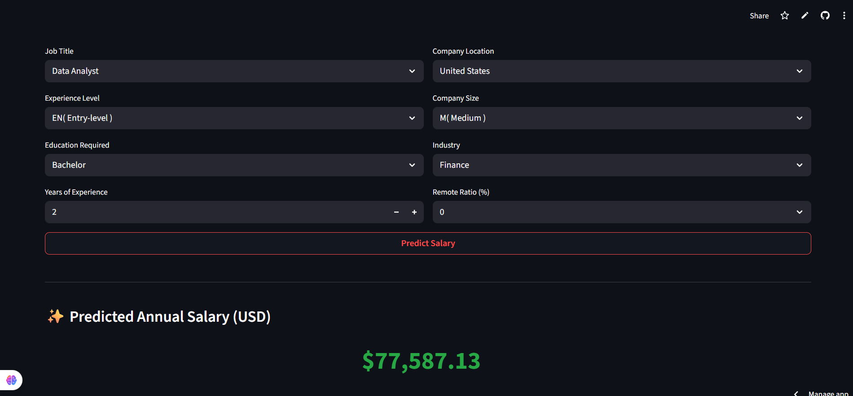
Result

Slide 13
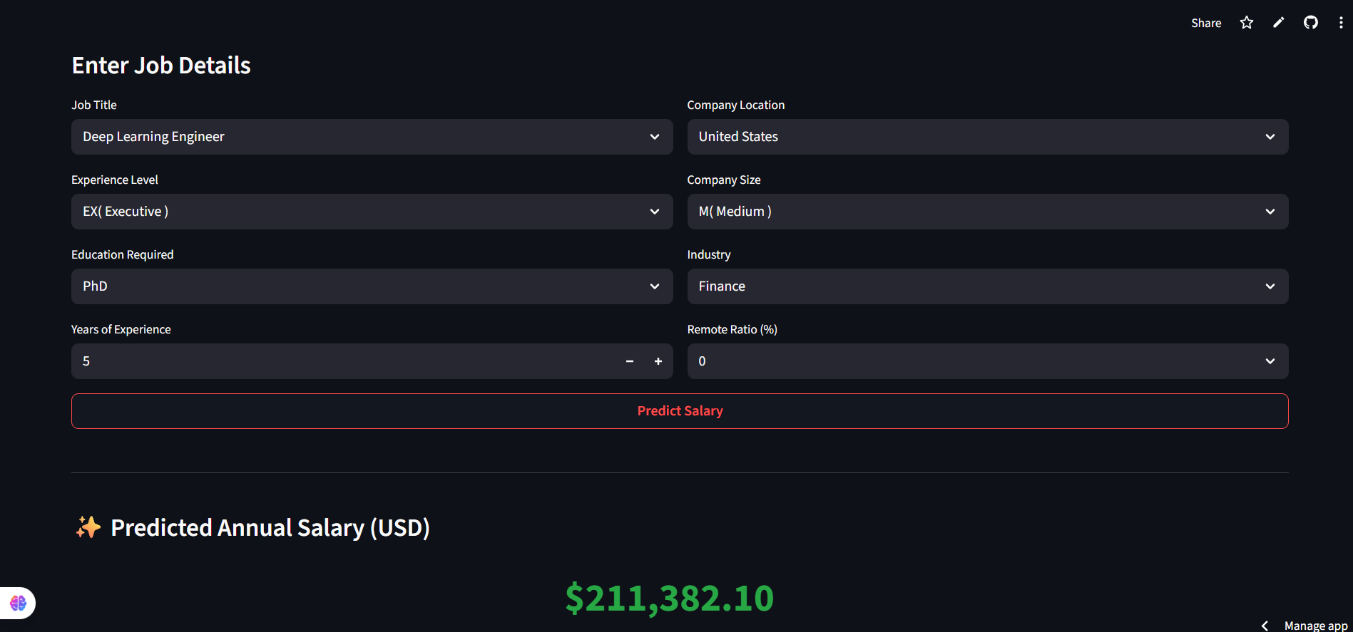
Result

Slide 14
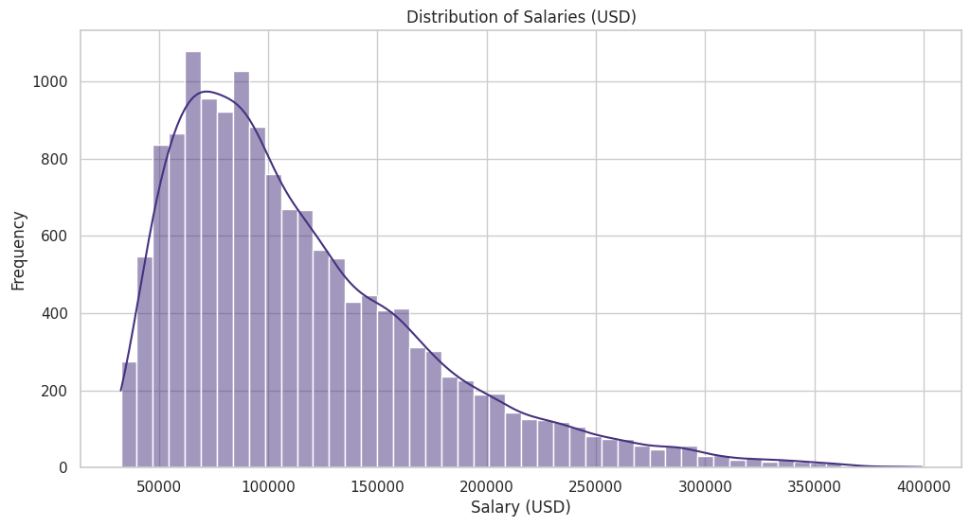
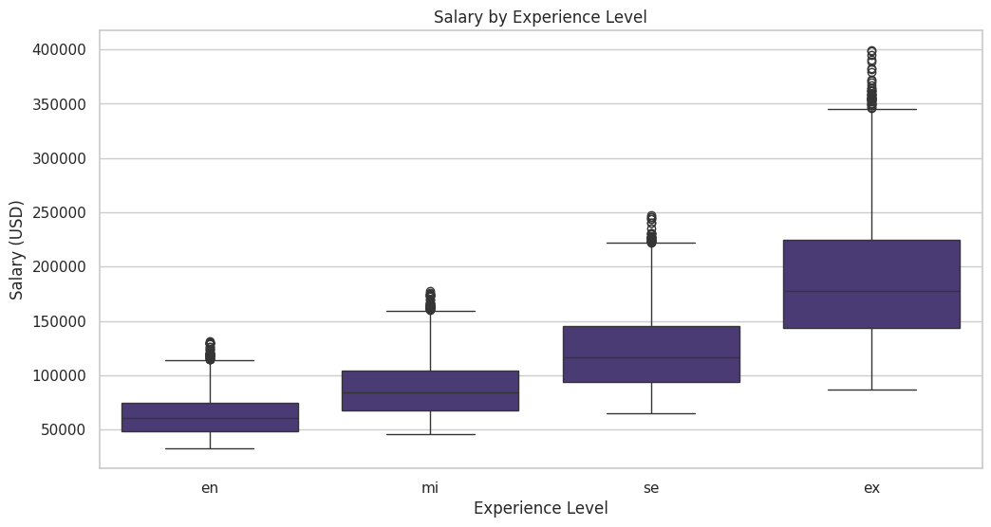
Result- EDA
Experienced employee are getting more salary and these are less in numbers.

Slide 15
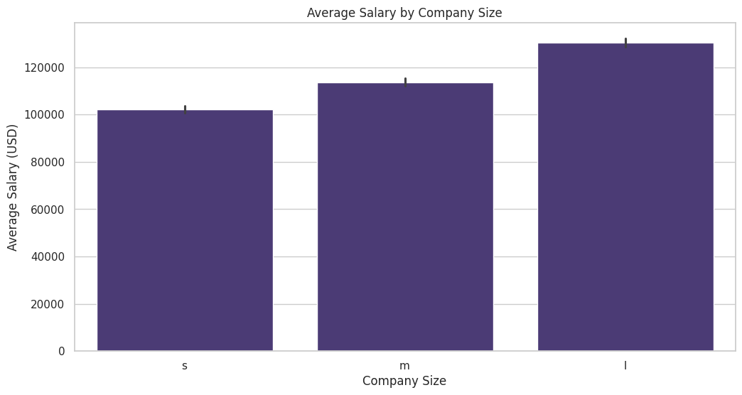
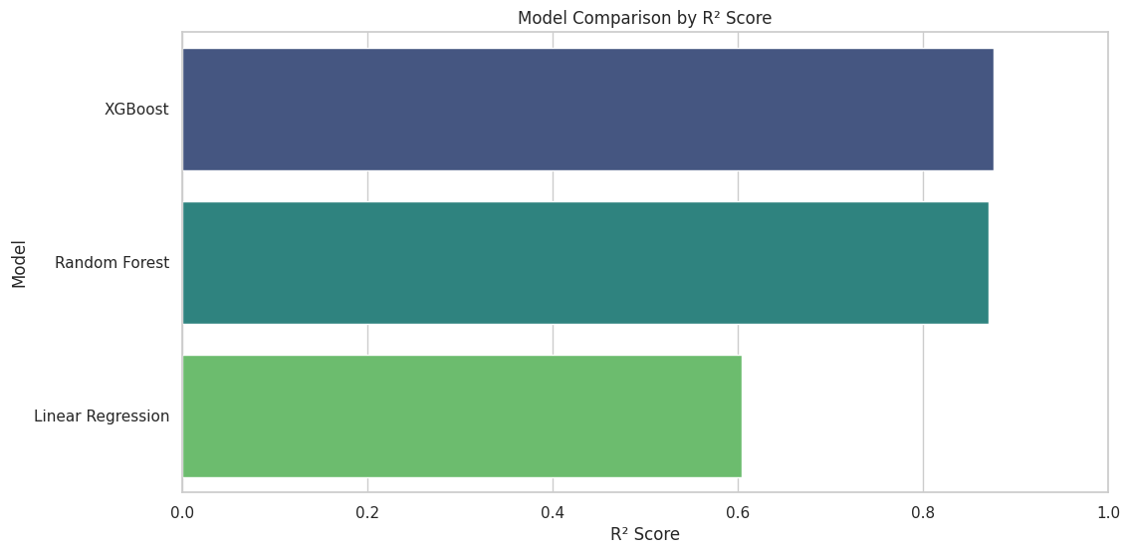
Result- EDA
Large size company are giving more salary as compared to small and medium size.
Testing the data Among these three model the XGBoost model has better accuracy than these two so I have chosen XGBoost model.

Slide 16
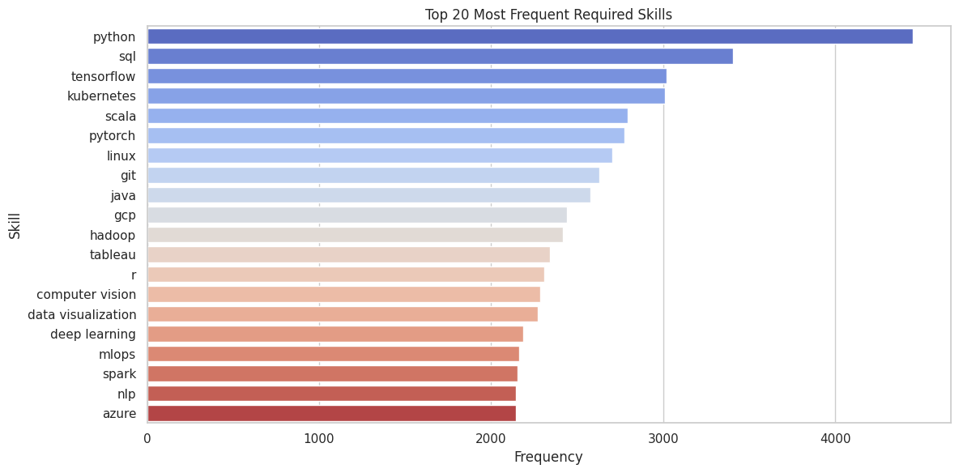
Result- EDA
From this data the Employee having these skillset getting more salary and the most popular skillset is Python

Slide 17
Result
GitHub :
https://github.com/vivekanandagiri/Employee-Salary-Prediction-ML-Project.git
Streamlit app Link :
https://employee-salary-prediction-ml-project-git-vivekananda.streamlit.app/

Slide 18
Conclusion
The Employee Salary Prediction project successfully demonstrates the application of advanced machine learning techniques to predict salaries for AI job roles with a high degree of accuracy. Through a structured pipeline involving comprehensive data preprocessing, robust feature engineering, and thorough exploratory data analysis, the project addresses many traditional challenges in salary determination—such as bias, inconsistency, and lack of transparency. Among the regression models tested, the XGBoost Regressor emerged as the most effective for predicting salaries based on multiple employee and job-related features.
While the regression models achieved strong results, the classification task for predicting remote work type showed that current features are insufficient, suggesting the need for richer or more targeted data for such tasks. Future work can focus on enhancing feature sets and extending the models for wider applicability across industries.

Slide 19
References
https://pandas.pydata.org/pandas-docs/stable/user_guide/index.html
https://seaborn.pydata.org/https://matplotlib.org/stable/contents.html
https://matplotlib.org/stable/contents.html
https://scikit-learn.org/stable/user_guide.html
https://www.kaggle.com/datasets/bismasajjad/global-ai-job-market-and-salary-trends-2025
https://docs.streamlit.io/

Slide 20
THANK YOU

